Slide 1

ELECTRONICS PROJECT
TOPIC: FULL WAVE bridge Rectifier
GROUP MEMBERS:
SUDHA CHAUDHRY
SRISTI AGRAWAL
SAMEEKSHA SRIVASTAVA
SECTION: A5 ,A6

Slide 2
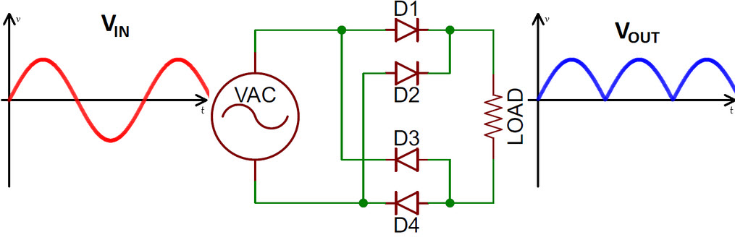
FULL WAVE BRIDGE RECTIFIER
Circuit Diagram with waveform:

Slide 3
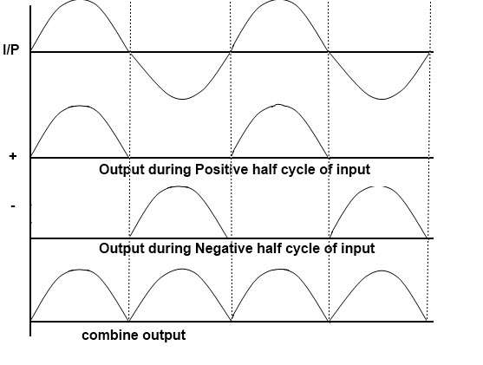
Full Wave Bridge Rectifier Circuit with Working
The average (DC) output voltage is higher than for half wave rectifier, the output of the full wave rectifier has much less ripple than that of the half wave rectifier producing a smoother output waveform.

Slide 4
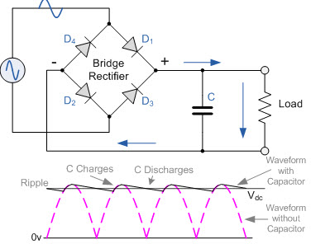
Full Wave Bridge Rectifier Theory
In a full wave rectifier circuit we use two diodes, one for each half of the wave. A multiple winding transformer is used whose secondary winding is split equally into two halves with a common center tapped connection. Configuration results in each diode conducting in turn when its anode terminal is positive with respect to the transformer center point C produces an output during both half-cycles. Full rectifier advantages are flexible compared to that of half wave rectifier.

Slide 5
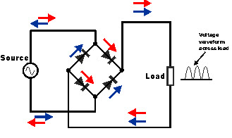
Working of Full Wave Bridge Rectifier
The peak voltage of the output waveform is the same as before for the half-wave rectifier provided each half of the transform windings have the same rms voltage. To obtain a different DC voltage output different transformer ratios can be used. The disadvantage of this type of full wave rectifier circuit is that a larger transformer for a given power output is required with two separate but identical secondary windings makes this type of full wave rectifying circuit costly compared to the Full Wave Bridge Rectifier circuit.

Slide 6
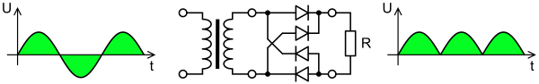
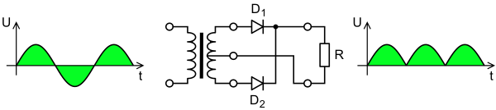
Full-Wave Bridge Rectification
Graetz bridge rectifier: a full-wave rectifier using four diodes.
Full-wave rectifier using a center tap transformer
V_{dc} = V_{av} = 2V_{peak} / π
V_{rms} = V_{peak}/√2

Slide 7
Difference between Full Wave Rectifier and Full Wave Bridge Rectifier
1.Full wave rectifier consist of two diodes whereas bridge rectifier consist of four diodes
2. In full wave rectifier only one diode worked during each half cycle whereas in bridge rectifier two diodes work at a time
3. Bridge rectifier produces dc with less ripples then the full wave rectifier
4. Full wave rectifier uses central tap transformer and bridge rectifier uses simple two winding single phase transformer

Slide 8
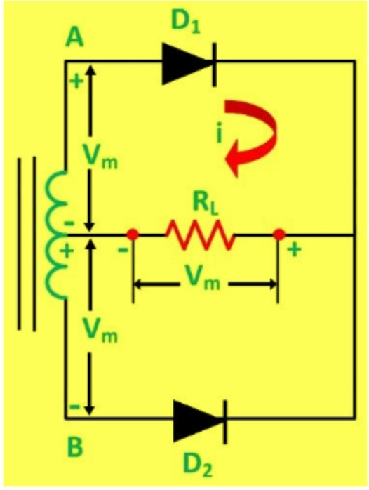
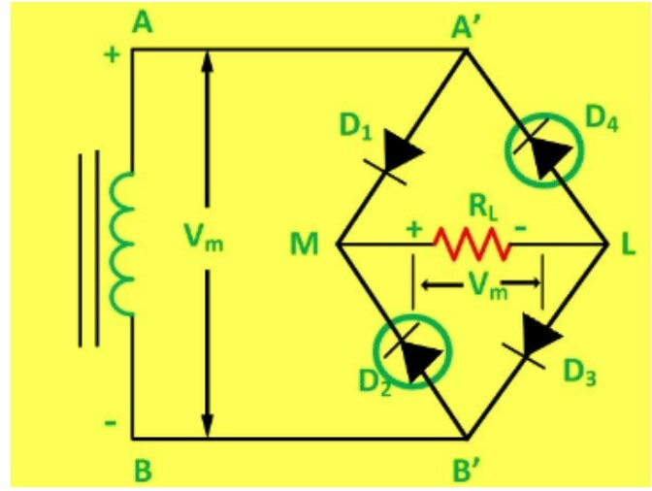
Full Wave Rectifier and Full Wave Bridge Rectifier
Full Wave Rectifier
Full Wave Bridge Rectifier

Slide 9
Applications
Car alternator
Any cell phone charger
Laptop/tablet charger
Power bank
Any other switching supply: alarm, charger, Bluetooth device charger, lan/router supply etc
Audio power supply in pre amp and power amplifier
Any video device
Lead battery charger
LED driver, any LED lamp over 10 watts in general

Slide 10
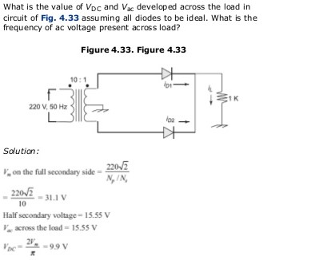
Numerical
Q1.

Slide 11
Conclusion
A bridge will conduct current whenever there is voltage present regardless of AC polarity as minus or plus therefore the name full wave rectifier.

Slide 12
Thank You

